Slide 1
Impact of New Projections Methodology
Employment Projections 2016-2026
Blania Calderon Cancel
Projection Economist Advanced
Fourth Annual WITS Ideas Sharing Forum
Division of Employment and Training
January 29, 2019
Crown Plaza, Madison WI

Slide 2
Wisconsin Employment Projections
US Department of Labor
U.S. Employment and Training Administration (ETA)
Office Of Economic Advisors (OEA)/Labor Market Information (LMI)
U.S. Bureau of Labor Statistics (BLS)
Projection Managing Partnership (PMP)
2

Slide 3
Updates Introduction
Separations Openings Method Results
Estimates of workers who leave their occupation and need to be replaced by a new worker
From Replacements: includes primarily retirements and deaths … to Separations: who is leaving the labor force entirely (exit rates) and those who are changing jobs and leaving an occupation (transfer rates)
Accounts for different types of job changes to ensure the data reflects today’s dynamic workforce
Foxconn Impact Project
3
Notes:
Separations: Estimate of openings resulting from workers transferring from one major occupation group to another (from one year to the next) or leaving the labor force (within a four-month period)
Permanent exit if the worker is OUT of the labor force for 4 consecutive months
New opening if the worker transfers from one occupation to another
Replacements: Estimate of openings resulting from workers retiring or otherwise permanently leaving an occupation; Net change in occupational employment for 13 different age cohorts over a 5-year period
Workers will continue to retire/exit an occupation at similar ages observed in the last 5 years
Is a permanent separation (exit) if the worker is replaced by a worker of a different age
Both:
Measure the same concept
Source data: Current Population Survey (CPS), March supplement

Slide 4
Separations Openings Method Results
Long-term Employment Occupational Projections, 2016-2026
4

Slide 5
WI Long-Term Projections Annual Openings, 2016-2026 - New Separations Methodology
Separations:
Labor Exits: 150,260
Occupational Transfers: 202,820
Growth: 21,020
Annual Openings: 374,100
“The once-traditional career path of entering an occupation at a young age and working until retirement in that same occupation is no longer the norm of American workers.”
Michael Wolf, Chief Division of Occupation Employment Projections
BLS
Source: DWD, Office of Economic Advisors, November 2018
5
Notes:
Replacements:
Annual Replacements 76,026
Annual Growth 21,955
Total Annual Openings 97,981

Slide 6
Separations Rates Context
What does 3.7 million openings mean?
Equivalent to every current worker either leaving the labor force or changing occupations once every 9 years
In contrast, 1 million openings implies workers remain in their occupation for 35 years, on average
6

Slide 7
Annual Separations (2016-2026) vs. Annual Replacements (2014-2024) - Results
Occupations | Exits | Transfer | Growth | Total
Total | 150,260 | 202,820 | 21,020 | 374,100
Management | 5,860 | 8,960 | 2,020 | 16,840
Financial | 4,720 | 9,650 | 1,620 | 15,990
Computer & Math | 1,400 | 3,860 | 1,090 | 6,360
Architect & Engineer | 1,390 | 2,550 | 630 | 4,570
Life & Social | 600 | 1,430 | 260 | 2,290
Community & Social | 1,830 | 3,090 | 520 | 5,450
Legal | 410 | 600 | 90 | 1,100
Education | 8,270 | 8,030 | 920 | 17,220
Arts & Media | 2,160 | 3,130 | 390 | 5,680
Occupations | Replacements | Growth | Total
Total | 21,960 | 76,030 | 97,980
Management | 1,630 | 4,880 | 6,510
Financial | 1,390 | 3,180 | 4,570
Computer & Math | 1,150 | 1,080 | 2,240
Architect & Engineer | 300 | 1,320 | 1,620
Life & Social | 270 | 720 | 990
Community & Social | 390 | 920 | 1,310
Legal | 50 | 280 | 330
Education | 900 | 5,640 | 6,540
Arts & Media | 290 | 1,320 | 1,610
Source: DWD, Office of Economic Advisors, December 2018 (Long-term 2016-26 new separations method vs. 2014-24 replacements method)
7
Notes:
Scenario #2: Includes Foxconn direct impact +13,000

Slide 8
Annual Separations (2016-2026) vs. Annual Replacements (2014-2024) - Results
Occupations | Exits | Transfer | Growth | Total
Health Practitioners | 4,560 | 4,480 | 1,480 | 10,560
Health Support | 4,490 | 4,330 | 810 | 9,630
Protective Service | 3,010 | 3,220 | 160 | 6,390
Food Prep and Serving | 19,110 | 24,830 | 2,630 | 46,570
Buildings Maintenance | 6,190 | 6,390 | 650 | 13,230
Personal Care | 12,730 | 11,920 | 2,750 | 27,400
Sales | 17,130 | 22,900 | 1,480 | 41,510
Admin Support | 22,840 | 26,670 | 300 | 49,800
Farming & Fishing | 1,130 | 3,450 | 180 | 4,750
Occupations | Replacements | Growth | Total
Health Practitioners | 1,320 | 3,550 | 4,860
Health Support | 910 | 1,640 | 2,550
Protective Service | 150 | 1,390 | 1,540
Food Prep and Serving | 2,250 | 8,880 | 11,130
Buildings Maintenance | 940 | 2,140 | 3,080
Personal Care | 2,600 | 3,030 | 5,630
Sales | 1,380 | 8,420 | 9,790
Admin Support | 1,400 | 9,420 | 10,830
Farming & Fishing | 130 | 1,660 | 1,790
Source: DWD, Office of Economic Advisors, December 2018 (Long-term 2016-26 new separations method vs. 2014-24 replacements method)
8

Slide 9
Annual Separations (2016-2026) vs. Annual Replacements (2014-2024) - Results
Occupations | Exits | Transfer | Growth | Total
Construction | 4,190 | 7,720 | 1000 | 12,900
Installation and Repair | 4,110 | 6,770 | 690 | 11,570
Production | 12,820 | 22,620 | -180 | 35,260
Transport & Material Moving | 11,290 | 16,220 | 1,530 | 29,040
Occupations | Replacements | Growth | Total
Construction | 1,010 | 1,690 | 2,690
Installation and Repair | 830 | 2,610 | 3,440
Production | 1,150 | 7,100 | 8,250
Transport & Material Moving | 1,530 | 5,170 | 6,700
Source: DWD, Office of Economic Advisors, December 2018 (Long-term 2016-26 new separations method vs. 2014-24 replacements method)
9

Slide 10
Foxconn Impact Project
Long-term Employment Industry and Occupational Projections,
2016-2026
10

Slide 11
Foxconn NAICS Classification Assumption
NAICS 334419: Other electronic component manufacturing
U.S. industry comprises establishments primarily engaged in manufacturing electronic components
Examples:
Crystals and crystal assemblies, electronic, manufacturing
Electron tubes manufacturing
LCD (liquid crystal display) unit screens manufacturing
Microwave components manufacturing
Printed circuit laminates manufacturing
Switches for electronic applications manufacturing
Transducers (except pressure) manufacturing
Piezoelectric devices manufacturing
11

Slide 12
Definitions
Direct effect:
Represent jobs on Foxconn payroll
Indirect effect:
Jobs resulting from Foxconn economic activity
Induced effect:
Jobs resulting from employee economic activity
Increase in income and people that will lead to increased demand for services
12
Notes:
Direct effect: change in final demand that the analyst inputs into IMPLAN
Indirect effect: additional economic activity from industries buying from other local industries
Induced effect: spending of labor income by the employees working in the indirectly-impacted industries (assumption that the more income households earn, the more money those households spend)

Slide 13
Wisconsin Output Demand
Sector | Employment | Event Year
Other Electronic Component Manufacturing | 13,000 | 2021
Impact Type | Employment
Direct Effect | 13,000
Indirect Effect | 4,240
Induced Effect | 6,340
Total Effect | 23,580
*Using IMPLAN multipliers
13
Notes:
IMPLAN code is 313: Other electronic component manufacturing
SAM Multiplier: 1.8 only Wisconsin
Type SAM Multiplier
A Type SAM Multiplier (where SAM stands for Social Accounting Matrix) is calculated by dividing the sum of the Direct Effects, Indirect Effects, and Induced Effects by the Direct Effects. The Induced Effects represent the spending of Labor Income by the employees working in the Indirectly-impacted Industries, under the assumption that the more income households earn, the more money those households spend. Note that IMPLAN does not assume that 100% of this Labor Income is spent, nor that it is spent locally. IMPLAN removes payroll taxes, personal income taxes, savings, in-commuter income, and non-local purchases before spending the rest locally. These leakages and expenditures are based on information in the SAM.

Slide 14
Top 5 Sectors Affected by the Indirect Effect
Management of companies and enterprises
Truck transportation
Employment services
Services to buildings
Maintenance and repair construction of nonresidential structures
*Using IMPLAN
14

Slide 15
Top 5 Sectors Affected by the Induced Effect
Hospitals
Full-service restaurants
Limited-service restaurants
Real estate
Retail-general merchandise stores
*Using IMPLAN
15

Slide 16
Wisconsin Employment Projections
Scenario #1: Employment
Scenario #2: Foxconn Direct Impact
+ 13,000 direct effect
Scenario #3: Foxconn Direct and Indirect/Induced Impact using IMPLAN
+ 13,000 direct effect
+ 4,240 indirect effect
+ 6,340 induced effect
16

Slide 17
Other Foxconn NAICS Classification Assumption
NAICS 541715: Research and Development in the Physical, Engineering, and Life Sciences (Racine, Green Bay and Eau Claire Innovation Centers)
U.S. industry comprises establishments primarily engaged in conducting research and experimental development in the physical, engineering, and life sciences, such as agriculture, electronics, environmental, biology, botany, computers, chemistry, food, fisheries, forests, geology, health, mathematics, medicine, oceanography, pharmacy, physics, veterinary and other allied subjects
17
Notes:
NAICS 3344 +12,025 (Racine)
NAICS 5417 +475 (Racine, Green Bay & Eau Claire)
NAICS 5511 +500 (Milwaukee)

Slide 18
Other Foxconn NAICS Classification Assumption
NAICS 55111: Management of Companies and Enterprises (Milwaukee Headquarter Office)
(1) establishments primarily engaged in holding the securities of (or other equity interests in) companies and enterprises for the purpose of owning a controlling interest or influencing management decisions or (2) establishments (except government establishments) that administer, oversee, and manage other establishments of the company or enterprise and that normally undertake the strategic or organizational planning and decision-making role of the company or enterprise. Establishments that administer, oversee and manage may hold the securities of the company or enterprise.
18

Slide 19
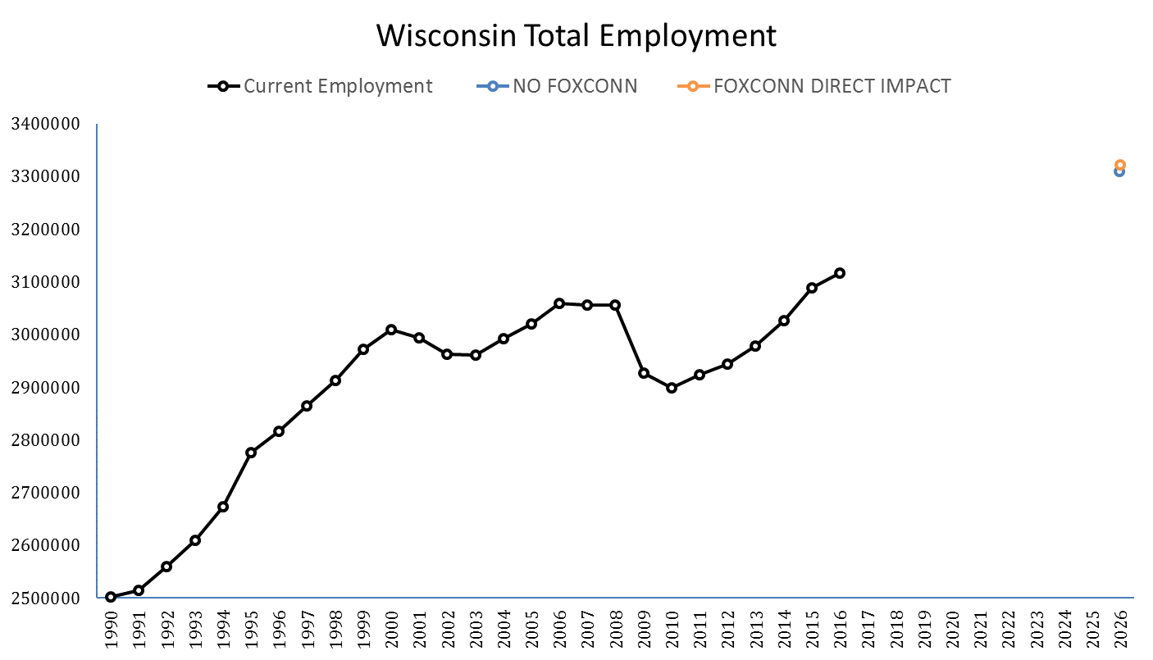
WI Long-term Industry Employment Projections, 2016-2026 Results
6.8%
6.3%
Source: DWD, Office of Economic Advisors, November 2018
19
Notes:
Last run of projections 2014-2024: Percent change of 6.02%

Slide 20
Wisconsin Total Employment Forecast Results
Scenarios | Projected Employment 2026 | Numeric Change (2016-2026) | Percent Change (2016-2026)
#1 Employment (No Foxconn) | 3,307,650 | 197,180 | 6.3 %
#2 Foxconn Direct Impact | 3,320,650 | 210,180 | 6.8 %
#3 Direct and Indirect/Induced Impact | - | - | -
Source: DWD, Office of Economic Advisors, November 2018
20

Slide 21
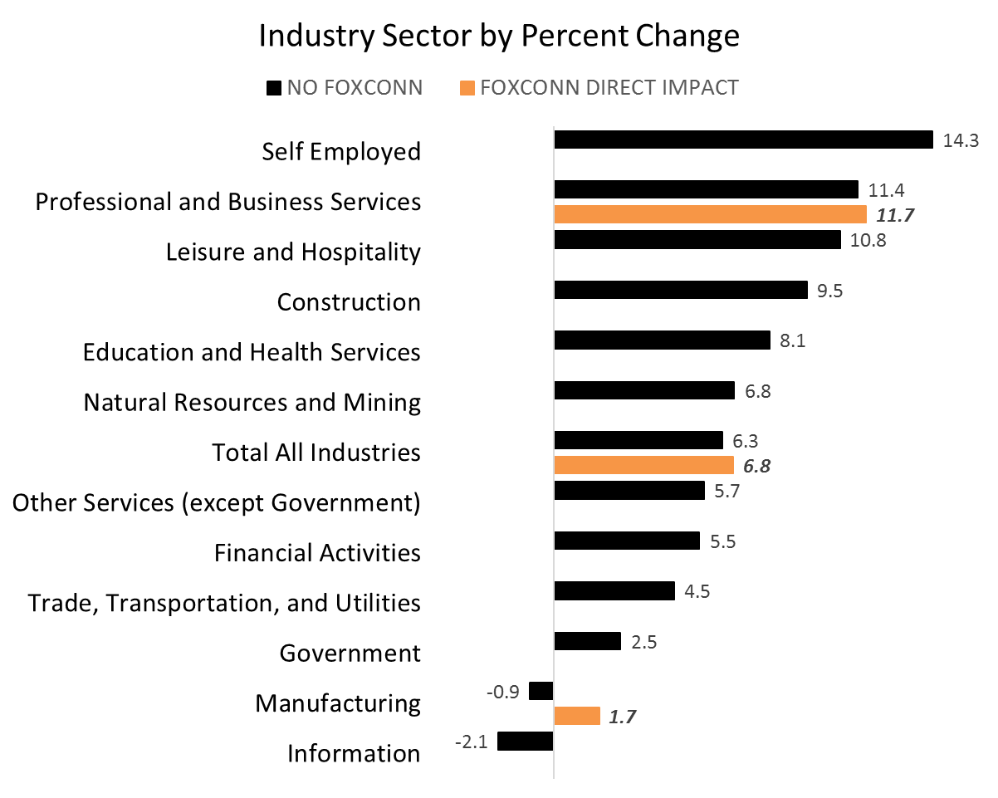
WI Long-term Industry Employment Projections, 2016-2026 - Results
Source: DWD, Office of Economic Advisors, November 2018
21
Notes:
Direct impact affecting mainly the Manufacturing Industry sector.

Slide 22
WI Long-term Occupational Employment Projections, 2016-2026 by % Change Results
22
Source: DWD, Office of Economic Advisors, November 2018
Notes:
By SOC Code
Direct impact affecting mainly the Architecture and Engineering; and Production occupational groups.

Slide 23
WDA Direct Effect Assumptions
WDA1 Southeast
NAICS 3344 +12,025
NAICS 5417 +125
WDA2 Milwaukee
NAICS 5511 +500
WDA5 Bay Area
NAICS 5417 +200
WDA8 West Central
NAICS 5417 +150
Source: DWD, Office of Economic Advisors, November 2018
23

Slide 24
WDA Direct Impact Industry Sector Forecast Scenario #1 and #2 Results
WDA | Employment 2016 | Employment 2026 | % Change (2016-2026)
1 Southeast Manufacturing Professional and Business Services | 34,345 16,141 | S1: 34,662 S2: 46,687 S1: 17,696 S2: 17,821 | S1: 0.92% S2: 35.94% S1: 9.63% S2: 10.41%
2 Milwaukee Professional and Business Services | 78,002 | S1: 84,109 S2: 84,609 | S1: 7.83% S2: 8.47%
5 Bay Area Professional and Business Services | 40,364 | S1: 45,433 S2: 45,622 | S1: 12.53% S2: 13.03%
8 West Central Professional and Business Services | 16,712 | S1: 18,971 S2: 19,121 | S1: 13.52% S2: 14.41%
Source: DWD, Office of Economic Advisors, November 2018
24

Slide 25
WDA Long-term Industry Employment Projections, 2016-2026 - Total Employment
Workforce Development Area | Employment 2016 | Projected Employment 2026 | Numeric Change (2016-2026) | Percent Change (2016-2026)
1 | 197,023 | 222,515 | 25,492 | 12.9
2 | 522,243 | 540,960 | 18,717 | 3.60
3 | 363,595 | 395,297 | 31,702 | 8.70
4 | 211,969 | 222,829 | 10,860 | 5.10
5 | 453,608 | 486,252 | 32,252 | 7.20
6 | 220,046 | 236,141 | 16,096 | 7.30
7 | 77,227 | 80,268 | 3,041 | 3.90
8 | 212,692 | 229,547 | 16,855 | 7.90
9 | 161,791 | 173,540 | 11,749 | 7.30
10 | 511,165 | 555,951 | 44,786 | 8.80
11 | 135,566 | 141,827 | 6,261 | 4.60
Source: DWD, Office of Economic Advisors, November 2018
25
Notes:
WDA 1, 3, 5, 6, 8, 9, and 10 are growing faster than WI
WDA 2, 4, 7 and 11 are growing slower than the state (color blue)

Slide 26
WDA Long-term Occupational Employment Projections, 2016-2026 - WDA1 Results
26
Source: DWD, Office of Economic Advisors, November 2018
Notes:
By SOC code
Other Occupational Groups with significant changes:
Business and Financial Operations;
Office and Administrative Support;
Computer and Mathematical

Slide 27
WDA Long-term Occupational Employment Projections, 2016-2026 - WDA2 Results
27
Source: DWD, Office of Economic Advisors, November 2018

Slide 28
WDA Long-term Occupational Employment Projections, 2016-2026 - WDA5 Results
28
Source: DWD, Office of Economic Advisors, November 2018

Slide 29
WDA Long-term Occupational Employment Projections, 2016-2026 - WDA8 Results
29
Source: DWD, Office of Economic Advisors, November 2018

Slide 30
Questions?
Blania Calderon Cancel
Projection Economist Advanced
608.267.7314
Blania.Calderon@dwd.wi.gov
http://dwd.wisconsin.gov

